Slide 1
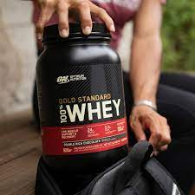
Hypothesis of
OPTIMUM NUTRITION WHEY PROTIEN

Slide 2
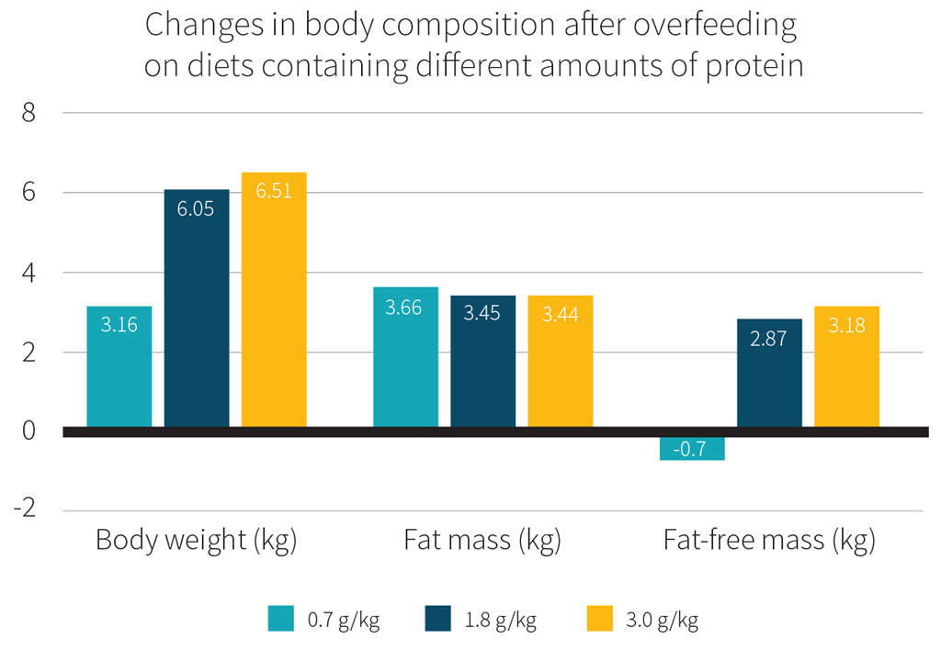
Observed Data

Slide 3
The ad from Optimum Nutrition
A progress of workout with consumption of optimum protein of a man ,Increases strength, Increases muscle gain, and helps to reduce body fat .
By comparing two guys one consumes optimum protein and the other one is doing the progress without consuming the whey protein .
They conveying that the rate of muscle gain of a individual ,who does the workout progress by consuming optimum protein is higher than the one who didn’t consume. And it also protects muscle loss
Now we are going to find whether it is true.(y)

Slide 4
Progress without consuming protein
Months | Muscle Growth | Endurance | Fat loss | Muscle Loss
JAN | 10.1lbs | 30% | 10% | 0.8
FEB | 15.8lbs | 50% | 15% | 2.0

Slide 5
Progress with consuming protein
Months | Muscle Growth | Endurance | Fat loss | Muscle Loss
JAN | 34.5lbs | 40% | 15.7% | 0.5
FEB | 45.6lbs | 60% | 20% | 0.2

Slide 6
HYPOTHESIS
Hypothesis for progress without consuming and a progress with consuming whey protien
The p value is p=0.04912
Since 0.04912<0.05
Here in this case the P value is less than alpha
So the hypothesis is accepted

Slide 7
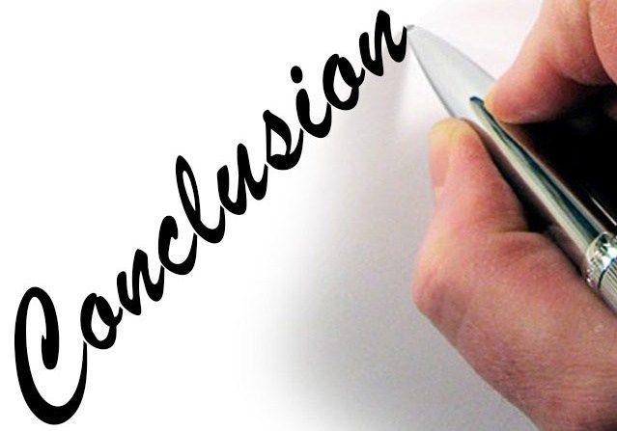
By conclusion
We proved that the rate of muscle gain of a individual who did the workout progress by consuming optimum protein is higher than the one who didn’t consume

